Slide 1
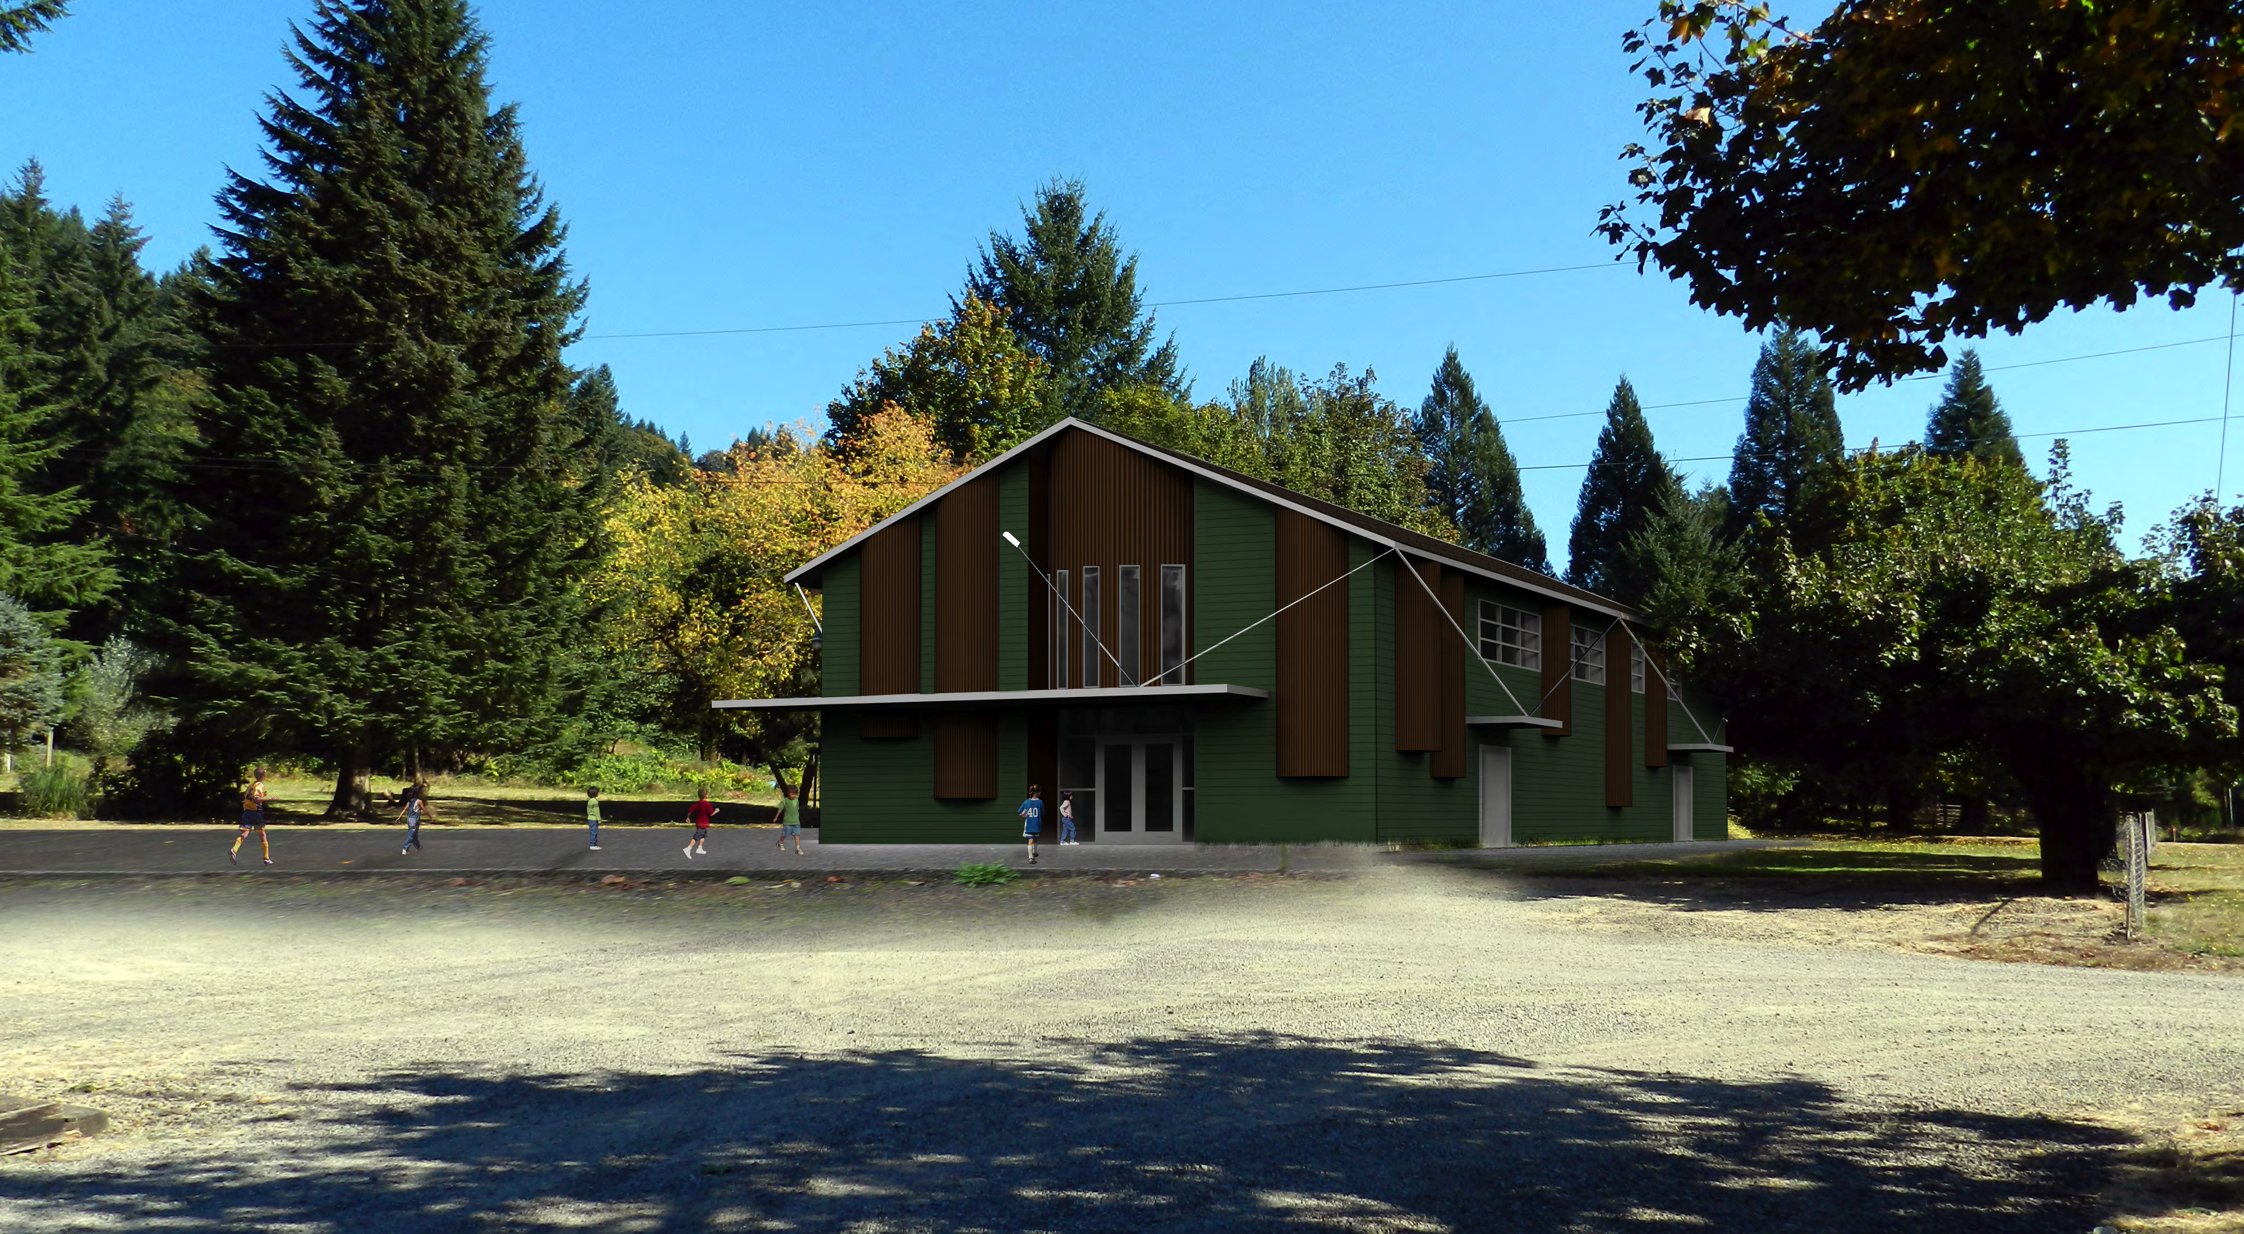
Yale Gym Design Update
Woodland School Board
April 8, 2013

